Slide 1

Analyzing Traffic Safety Data with Python

Slide 2
Sources:
National Highway Traffic Safety Administration
Pew Research Center’s Website
This dataset comprises monthly total numbers of collisions in the United States from 2006 to 2020 normalized to the population size. This dataset was cleaned and modified to aggregate collisions with different outcomes to streamline our analysis.
This dataset comprises the quarterly percent of American adults that report owning and using a smartphone. This dataset has been cleaned and modified to only include information relevant to our analyses.

Slide 3
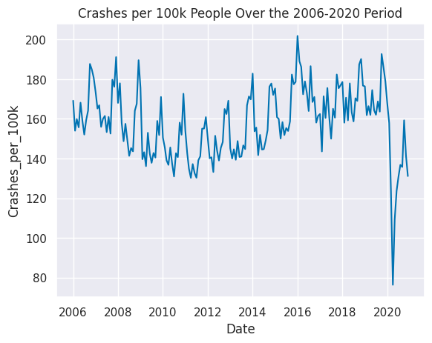
Looking at the line plot of our collision data, we can see the decreasing trend in crash rates from 2006 continuing until 2010 or 2011, and then crash rates begin increasing. The data for 2020 is very different from the preceding years.
There also appear to be cyclical patterns, which may indicate differing crash rates by season.

Slide 4
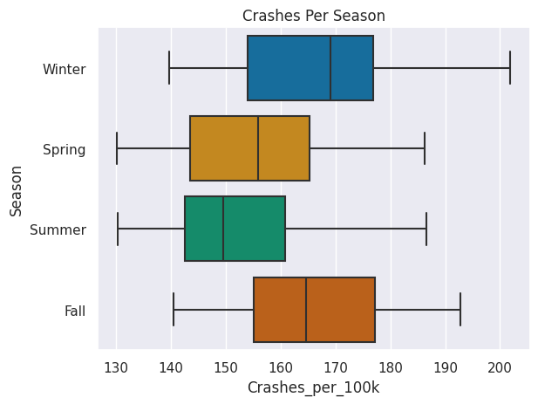
Winter and Fall appear to have generally higher crash rates than Spring and Summer. Seasons may be the reason for the pattern in crash rates.

Slide 5
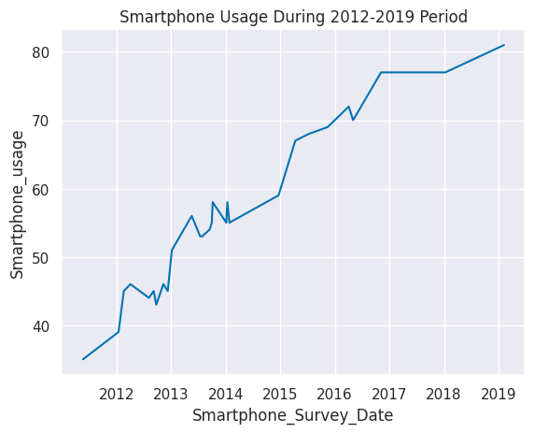
We can see a trend of smartphone usage increasing over time.

Slide 6
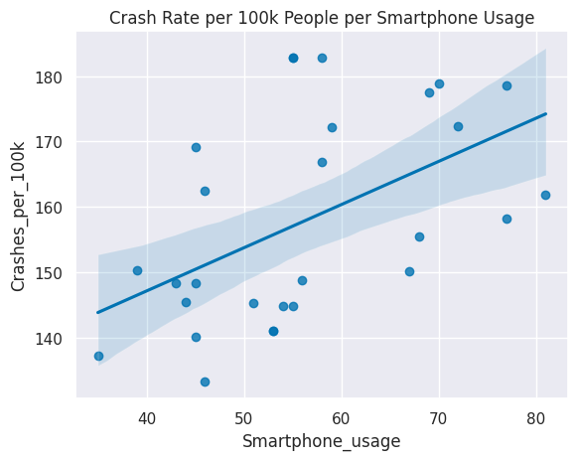
There appears to be a positive linear relationship between the rate of car crashes and the rate of adult smartphone usage in the U.S.
Calculating the Pearson’s r correlation coefficient and the associated p-value we find that:
Pearson's r = 0.513
p = 0.005
The Pearson's r correlation coefficient is greater than 0.5, which indicates a moderately strong positive relationship. The p-value is less than 0.05. Together, this tells us that there is a statistically significant correlation between adult smartphone usage rates and car crash rates in the U.S.

Slide 7
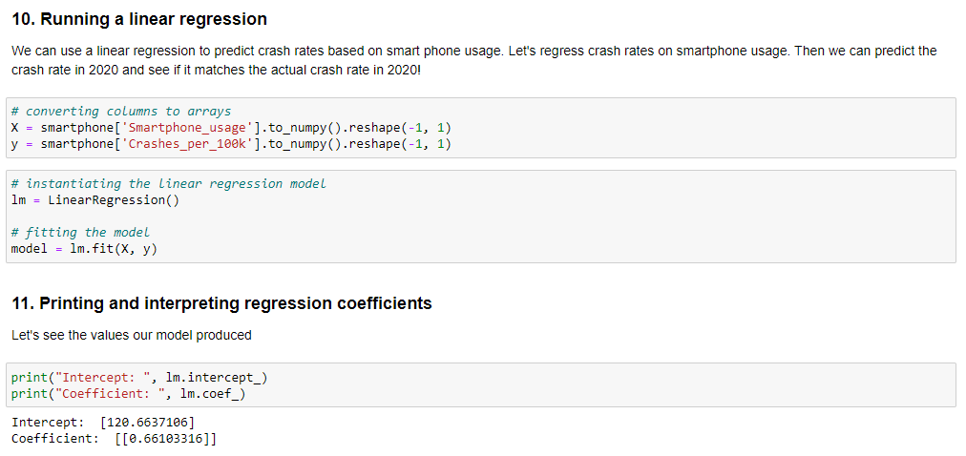

Slide 8
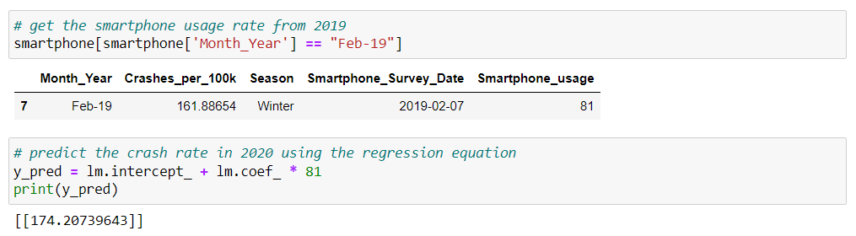
From our model output, the regression line equation is Crashes_per_100k = 120.6637 + (0.6610 * Smartphone_usage). We'll run the code to view the smartphone usage rate for 2019. Then substitute this value into the equation, using Python as a calculator to predict the crash rate for 2020.

Slide 9
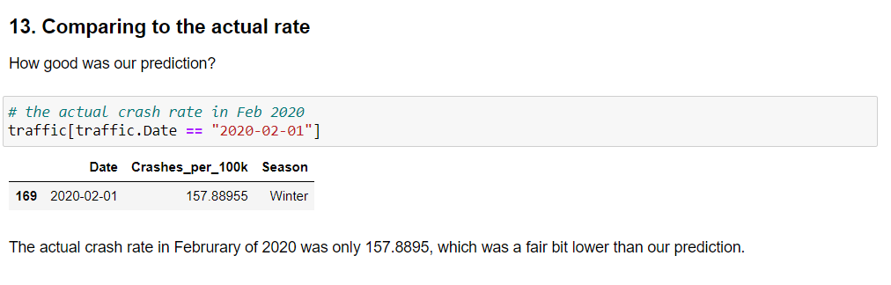

Slide 10
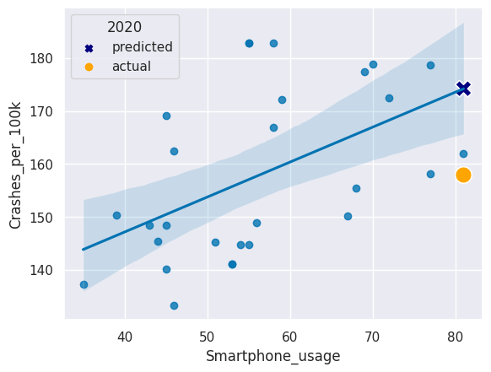
By adding another layer to our regression plot, we can see the difference between the predicted and real crash rates in February 2020. This allows us to see how these values compare to the rest of the dataset.

